Slide 1
PREDICTING CAR ACCIDENT SEVERITY FROM ENVIRONMENTAL VARIABLES
ANDRÉS MORA
22.sep.2020

Slide 2
INTRODUCTION
Local government institutions are accountable for organizing traffic circulation and guaranteeing traffic safety in their respective jurisdictions.
This is of special relevance when dealing with the most unfortunate traffic-related occurrence:
CAR ACCIDENTS

Slide 3
INTRODUCTION
A long held intuition supposes that car accident severity can worsen given certain environmental conditions, like those related to weather, lighting, or the road conditions.
Were this true, government institutions could use such information to design and implement more effective traffic safety measures.
So: CAN ENVIRONMENTAL CONDITIONS PREDICT THE SEVERITY OF A CAR ACCIDENT?

Slide 4
DATA
SOURCE
Car accident data registered by the Seattle, WA jurisdiction since 2004 until present time
Administered by the SDOT (Seattle Department of Transportation) and the organization Traffic Records Group
Open to public

Slide 5
DATA
CLEANING
1) Identify target variable: ‘Car Accident Severity’
2) Identify independent variables:
Environmental features: ‘Weather’, ‘Lighting Conditions’, and ‘Road Conditions’
3) Drop missing data, and data labeled as ‘unknown’ or ‘other’
Final dataset: 169,949 car accidents

Slide 6
METHODOLOGY
CATEGORICAL ANALYSIS: Proposal
a) visualizing frequencies
a count-plot in to visually recognize frequency distribution
c) applying categorical correlation metrics
a Cramer’s V test to obtain the strength of association
b) obtaining distribution percentages
a contingency table to demonstrate numerically such distribution

Slide 7
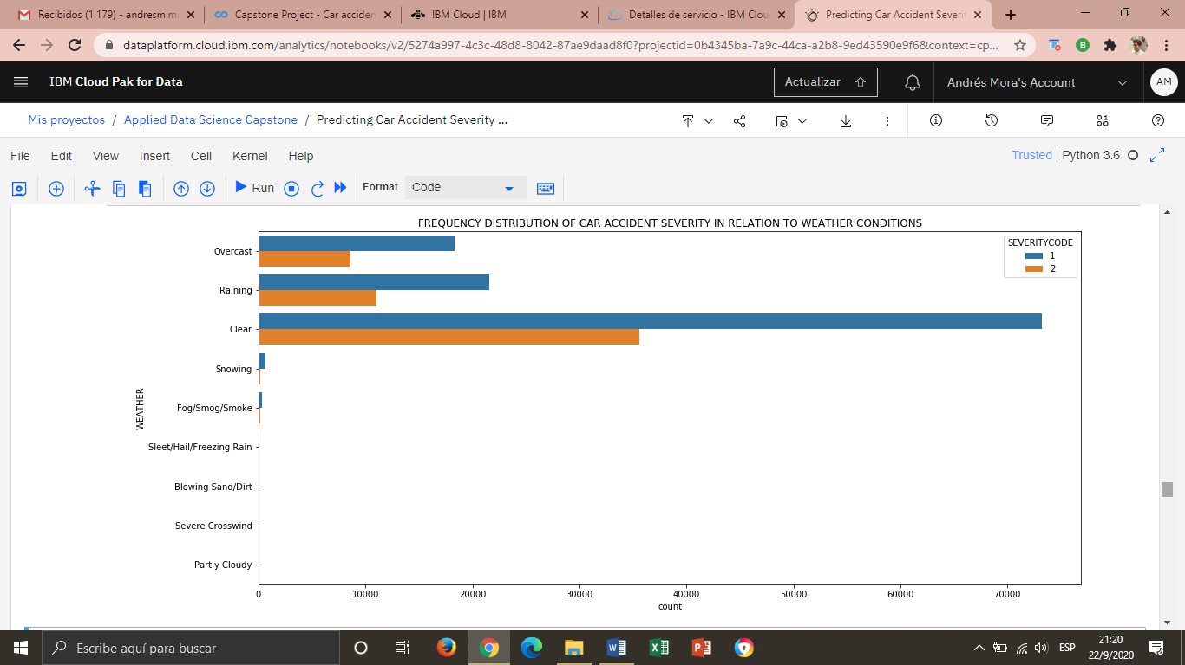
RESULTS 1. Relationship between CAR ACCIDENT SEVERITY and WEATHER
a) visualizing frequencies

Slide 8
RESULTS 1. Relationship between CAR ACCIDENT SEVERITY and WEATHER
Almost all data is concentrated under ‘Clear’ weather.
Differences of severity only happen in the three top labels.
The majority of accidents point a low score in severity: only property damage.
a) visualizing frequencies

Slide 9
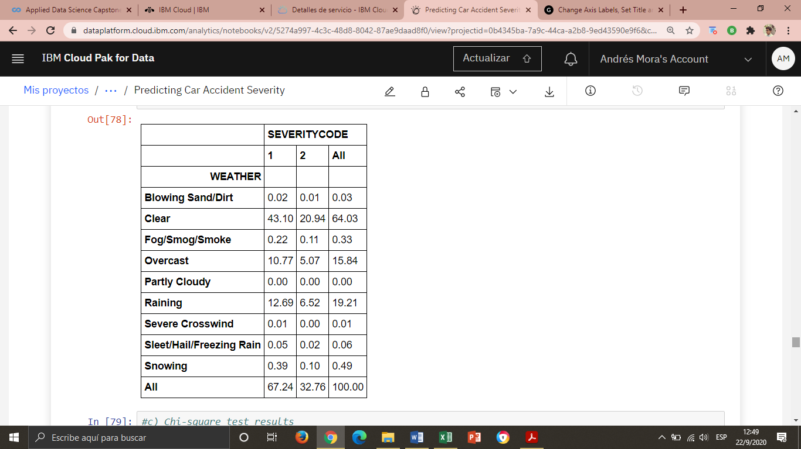
RESULTS 1. Relationship between CAR ACCIDENT SEVERITY and WEATHER
b) obtaining distribution percentages
64,03% of car accidents occur under ‘Clear’ weather: 2/3 correspond to property damage severity, and 1/3 to injury severity.
Differences of severity only happen in the three top labels.

Slide 10
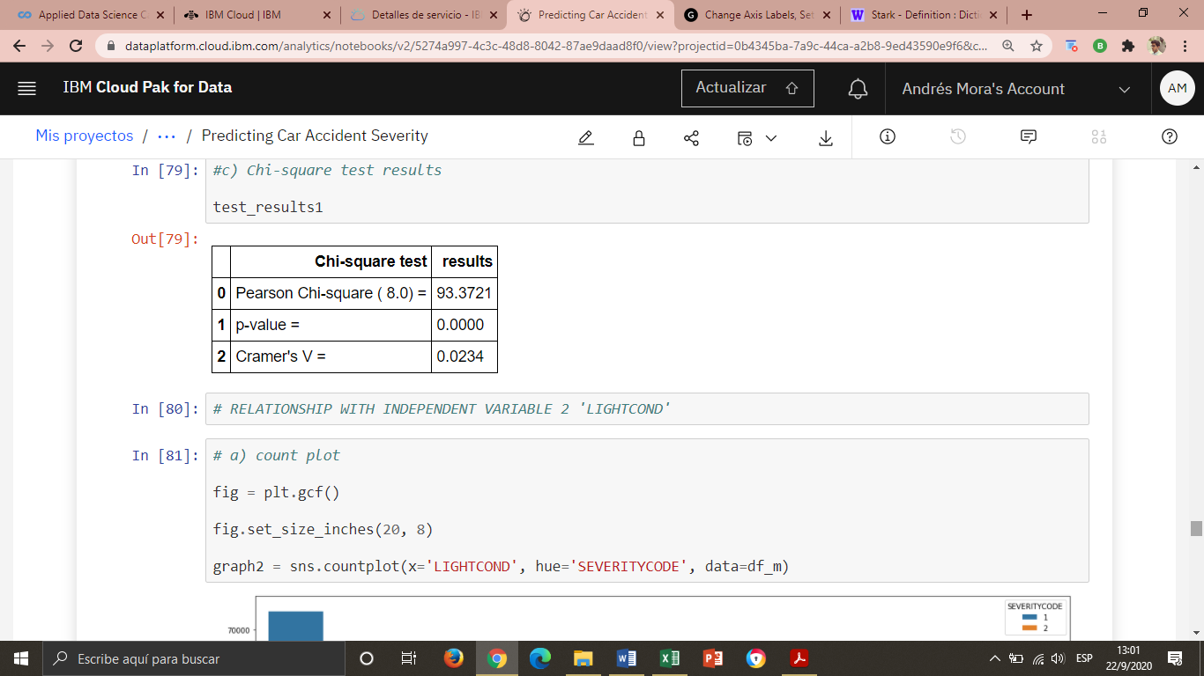
RESULTS 1. Relationship between CAR ACCIDENT SEVERITY and WEATHER
c) applying categorical correlation metrics
The Cramer’s V, the most reliable metric, shows a very weak association.

Slide 11
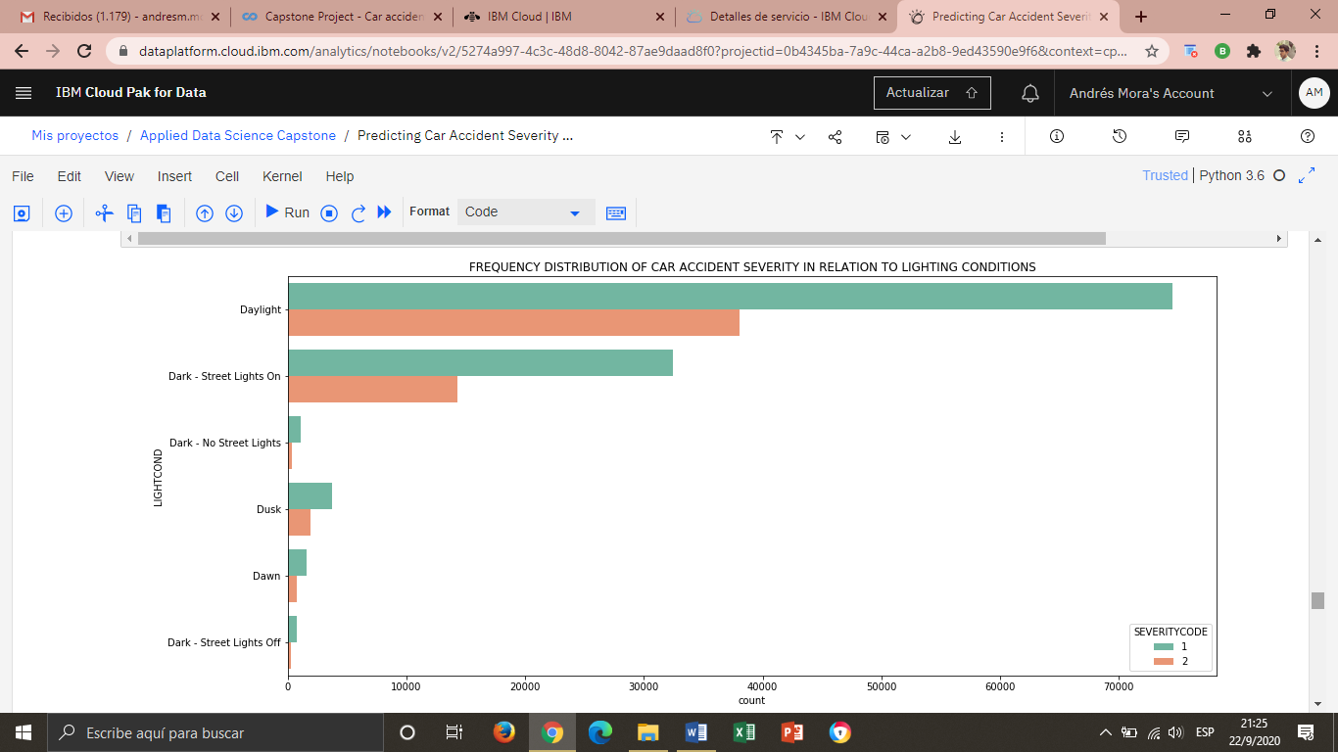
RESULTS 2. Relationship between CAR ACCIDENT SEVERITY and LIGHTNING CONDITIONS
a) visualizing frequencies

Slide 12
RESULTS 2. Relationship between CAR ACCIDENT SEVERITY and LIGHTNING CONDITIONS
Almost all data is concentrated under ‘Daylight’.
Differences of severity only happen in the top two labels.
The majority of accidents point a low score in severity: only property damage.
a) visualizing frequencies

Slide 13
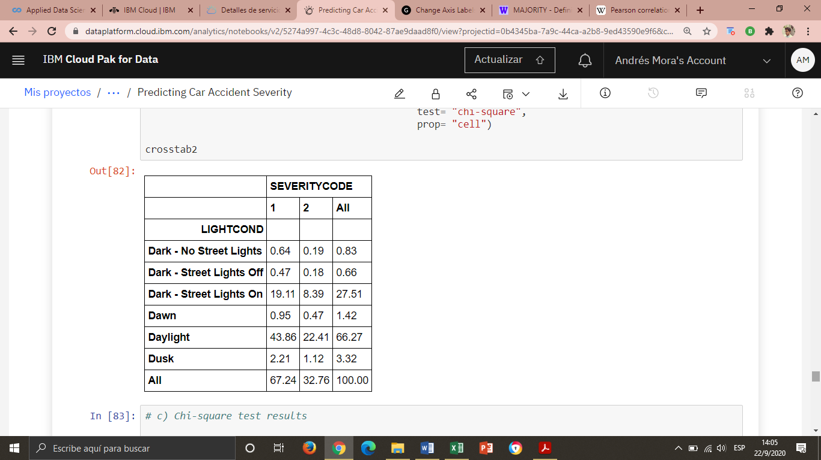
RESULTS 2. Relationship between CAR ACCIDENT SEVERITY and LIGHTNING CONDITIONS
b) obtaining distribution percentages
66,27% of car accidents occur under ‘Daylight’: 2/3 correspond to property damage severity, and 1/3 to injury severity.
Differences of severity only happen in the three top labels

Slide 14
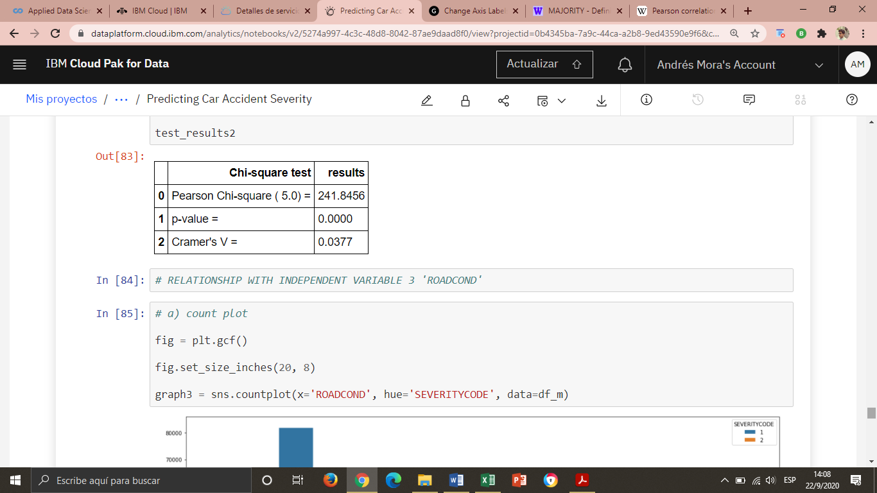
RESULTS 2. Relationship between CAR ACCIDENT SEVERITY and LIGHTNING CONDITIONS
c) applying categorical correlation metrics
The Cramer’s V, the most reliable metric, shows a very weak association.

Slide 15
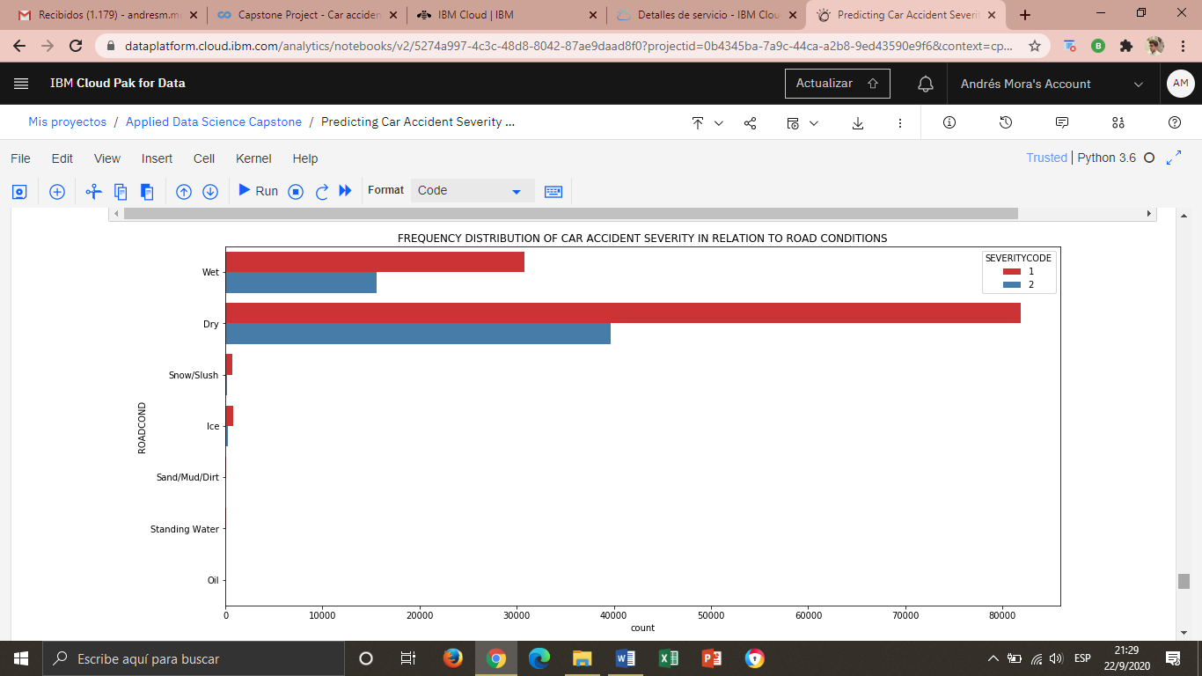
RESULTS 3. Relationship between CAR ACCIDENT SEVERITY and ROAD CONDITIONS
a) visualizing frequencies

Slide 16
RESULTS 3. Relationship between CAR ACCIDENT SEVERITY and ROAD CONDITIONS
Almost all data is concentrated under ‘Dry’ road conditions.
Differences of severity only happen in the top two labels.
The majority of accidents point a low score in severity: only property damage.
a) visualizing frequencies

Slide 17
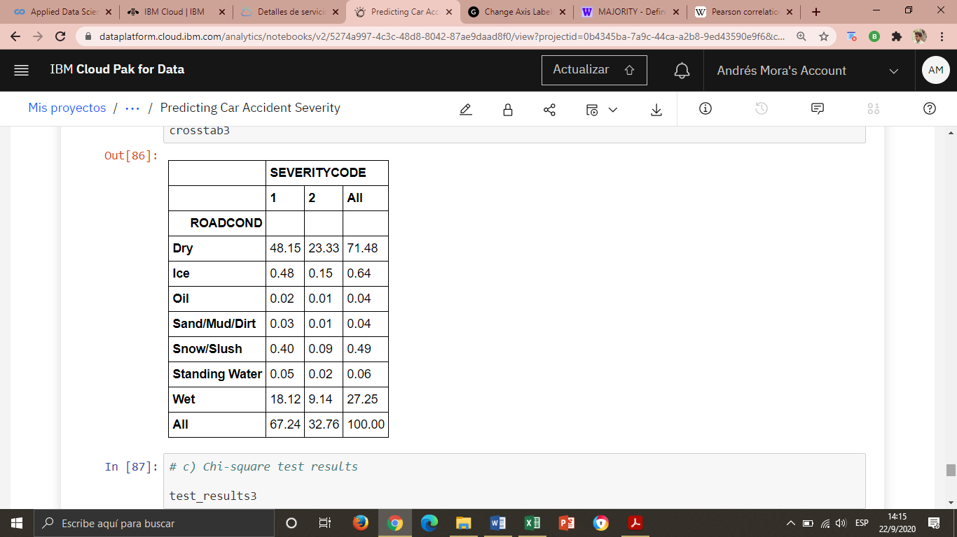
RESULTS 3. Relationship between CAR ACCIDENT SEVERITY and ROAD CONDITIONS
b) obtaining distribution percentages
71,48% of car accidents occur under ‘Dry’ road conditions: 2/3 correspond to property damage severity, and 1/3 to injury severity.
Differences of severity only happen in the three top labels

Slide 18
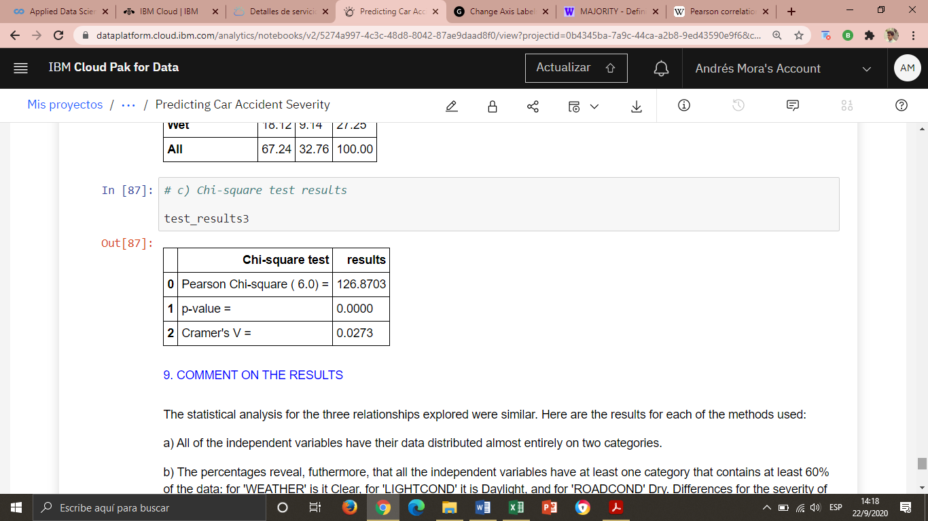
RESULTS 3. Relationship between CAR ACCIDENT SEVERITY and ROAD CONDITIONS
c) applying categorical correlation metrics
The Cramer’s V, the most reliable metric, shows a very weak association.

Slide 19
DISCUSSION
CATEGORICAL ANALYSIS: results brief
a) visualizing frequencies
b) obtaining distribution percentages
Almost all of the data is distributed under one label.
All the environmental variables have one category that contains at least 60% of the data: for 'Weather' it is Clear, for 'Light Conditions' it is Daylight, and for 'Road Conditions' Dry.
Differences for the severity occur only in top labels of each variable.
c) applying categorical correlation metrics
The metrics show a very weak relationship.

Slide 20
CONCLUSIONS
None of the environmental variables displayed a significant relationship predicting the severity of a car accident: no predictive model can be obtained out of them.
The great majority of car accidents happen under “normal” environmental conditions: clear weather, daylight, dry road.
The Seattle, WA jurisdiction registered no car accident severity above “injury”.

Slide 21
CONCLUSIONS
The aforementioned suggests that car accidents happening in this jurisdiction are not severe and that such severity is not connected to environmental conditions.
The severity of car accident might have to be studied regarding human and/or machine related variables.

